Slide 1

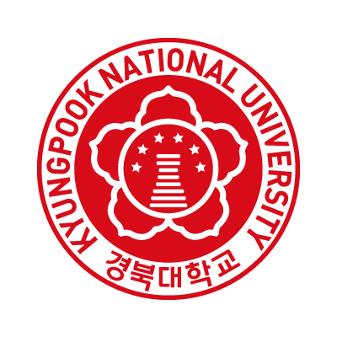
Mathematica for Education
in the AI Age:
Practical Applications
in EM/RF Engineering
Kyungpook National Univ.
Microwave Convergence Lab.
김 강 욱 교수
Presentation for
2026년
한국 Wolfram
기술 컨퍼런스

Slide 2

KNU Microwave Convergence Lab.
Motivation:
Education in the AI Age
2

Slide 3
KNU Microwave Convergence Lab.
Education in the AI Age
Motivation
Motivation: Education in the AI Age
Advanced AI tools (e.g., ChatGPT, Gemini,…) can greatly assist students in solving problems, writing code, and exploring ideas.
However, core understanding of physics and mathematics remains indispensable, now and in the future.
Without fundamental understanding:
AI-generated results cannot be judged for correctness
Hidden assumptions and limitations are easily overlooked
Physically incorrect solutions may appear convincing
AI can assist reasoning, but it cannot replace understanding!
3

Slide 4
KNU Microwave Convergence Lab.
Education in the AI Age
Motivation
Uncomfortable but honest truth for AI (1/3)
Physics decides what is correct.
AI can automate mistakes, but it cannot recognize them.
If students, rely on AI answers
Without physics / mathematics / EM fundamentals
Without symbolic verification (e.g., using Mathematica)
Without sanity checks
They will:
Reproduce old mistakes faster
Design brittle systems
Lose the ability to detect conceptual errors
4

Slide 5
KNU Microwave Convergence Lab.
Education in the AI Age
Motivation
Uncomfortable but honest truth for AI (2/3)
AI does not correct the past, but it averages the past.
If the past contains errors,
AI will faithfully reproduce those errors.
Scientific correction happens when:
Someone understands deeper physics &
challenges accepted explanations &
publishes better interpretations
AI alone cannot do that.
5

Slide 6
KNU Microwave Convergence Lab.
Education in the AI Age
Motivation
Uncomfortable but honest truth for AI (3/3)
AI should be used as:
A cross-check
A hypothesis generator
A documentation assistant
A search accelerator
But never as:
The final authority
The judge of correctness
The source of physical truth
6

Slide 7
KNU Microwave Convergence Lab.
Computational Tools in Education
Proper Role of Computational Tools in Education (1/3)
Manual derivation and analytical reasoning are essential for:
Developing physical intuition
Understanding assumptions and constraints
Learning how equations are constructed
At the same time, students should learn how to:
Verify derivations
Explore parameter dependence
Visualize physical behavior
Symbolic and numerical tools such as Mathematica and MATLAB provide an ideal bridge between:
Theory and practice
Equations and physical insight
7

Slide 8
KNU Microwave Convergence Lab.
Mathematica in Education
Effectiveness 1/2
Why Mathematica is Especially Effective for Education (2/3)
Many textbook problems can be efficiently handled using simple Mathematica programs, including:
Engineering Mathematics
Engineering Physics
Electromagnetic / RF / Microwave Engineering
Elementary to High-School Mathematics and Physics
A short introductory tutorial (~1 hour) enables students to:
Manipulate equations symbolically
Check manual derivations
Generate plots and physical visualizations
8

Slide 9
KNU Microwave Convergence Lab.
Mathematica in Education
Effectiveness 2/2
Why Mathematica is Especially Effective for Education (3/3)
Mathematica’s textbook-like notation:
Closely matches standard mathematical expressions
Reduces cognitive load compared to traditional programming
Helps students focus on concepts, not syntax
9

Slide 10
KNU Microwave Convergence Lab.
Practical Teaching Cases
At Kyungpook National University (KNU)
10

Slide 11
KNU Microwave Convergence Lab.
Practical Teaching Cases
At Kyungpook National University (KNU)
Lecture Notes Written Directly in Mathematica (1/3)
Easy starting point using structured templates
Natural equation input:
LaTeX / MathML compatible
MS Word equation compatibility
Fast Greek-letter input
Easy modification of notations to keep consistency
Well-organized lecture materials:
Foldable chapters and sections
Clear separation of derivation, explanation, and computation
11

Slide 12
KNU Microwave Convergence Lab.
Practical Teaching Cases
At Kyungpook National University (KNU)
Lecture Notes Written Directly in Mathematica (2/3)
Strong visualization capability:
2D / 3D plots
Field distributions
Time-/Frequency-domain behavior
Interactive learning using Manipulate:
Real-time parameter variation
Immediate physical intuition
Symbolic computation enables:
Verification of analytical derivations
Checking limiting cases
Consistency validation
12

Slide 13
KNU Microwave Convergence Lab.
Practical Teaching Cases
At Kyungpook National University (KNU)
Lecture Notes Written Directly in Mathematica (3/3)
Interactive CDF files can be distributed to students without license barriers.
Applied to:
Undergraduate courses
Introductory RF Engineering
Wireless Engineering
Laboratories
Graduate courses
Electromagnetic Wave Engineering
Microwave Devices
13

Slide 14
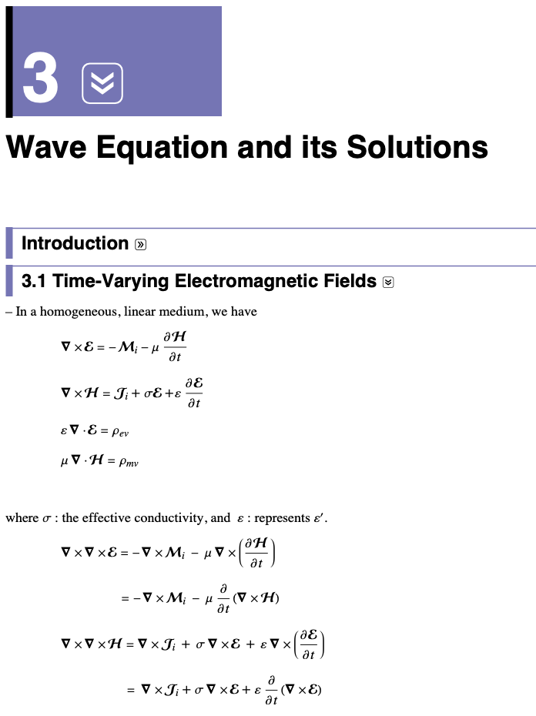
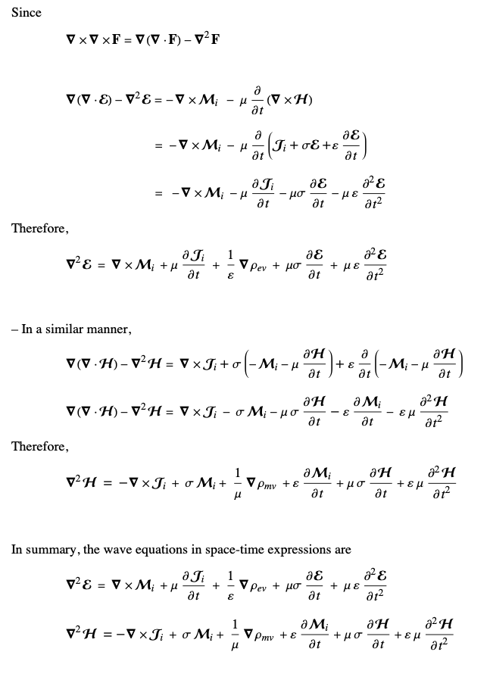
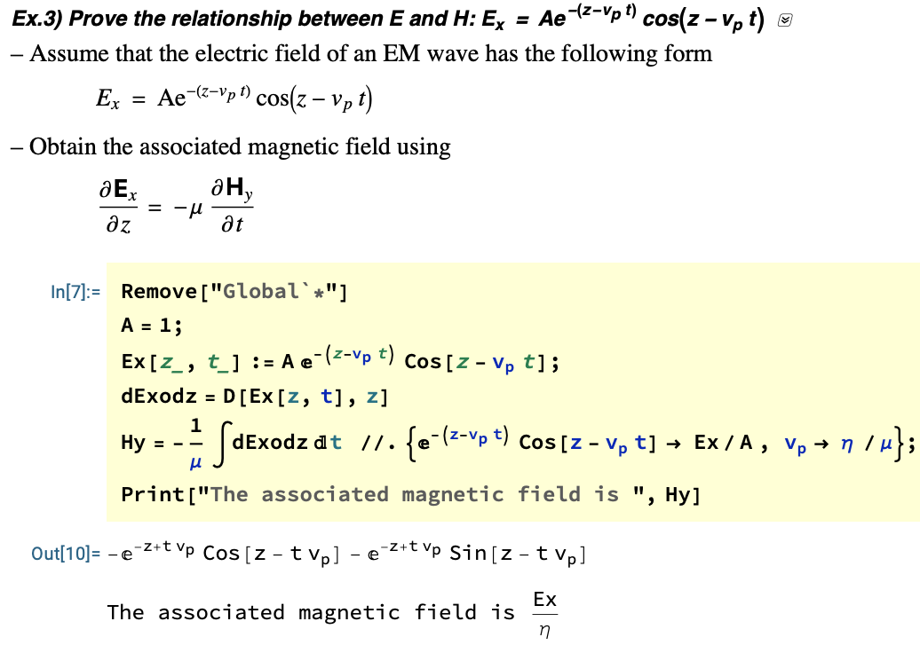
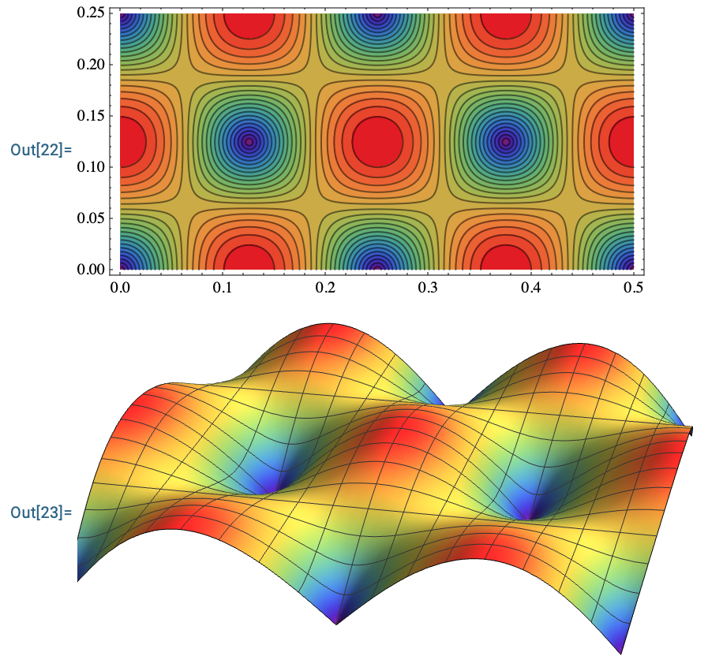
KNU Microwave Convergence Lab.
Practical Teaching Cases
At Kyungpook National University (KNU)
Lecture Note Example 1: EM-wave Propagation (Graduate)
14

Slide 15
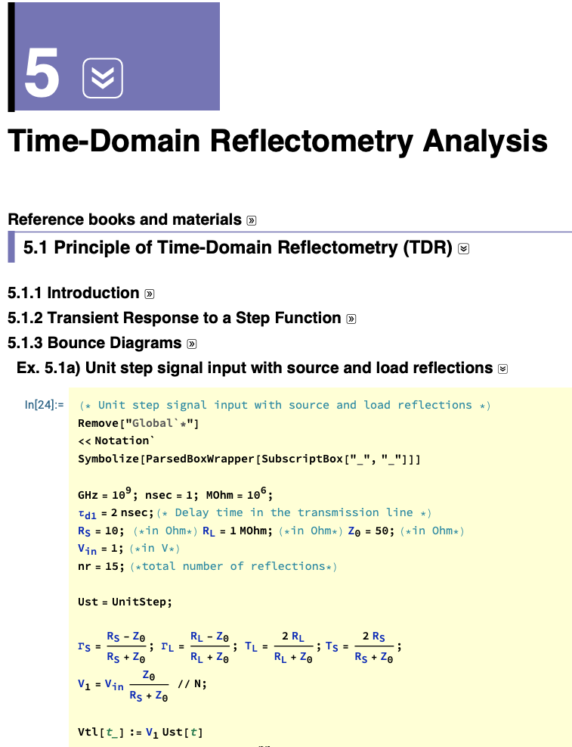
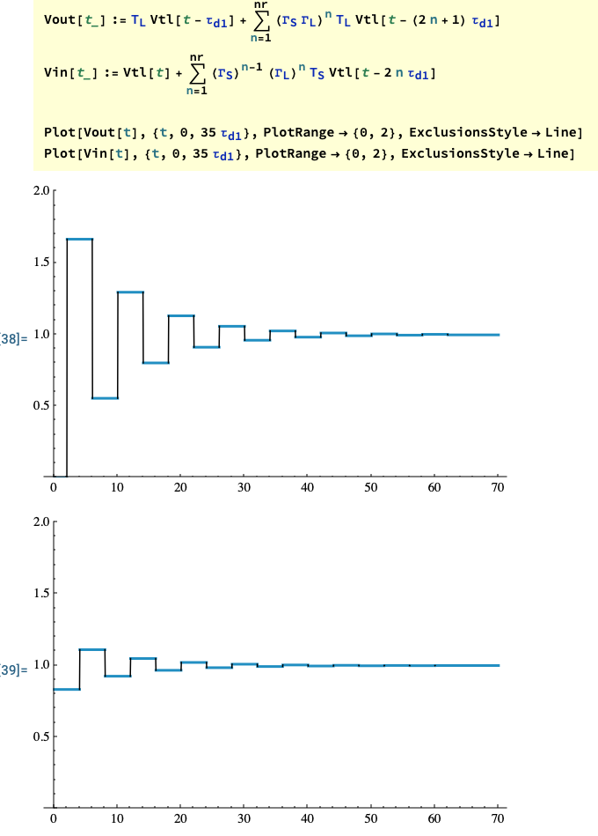
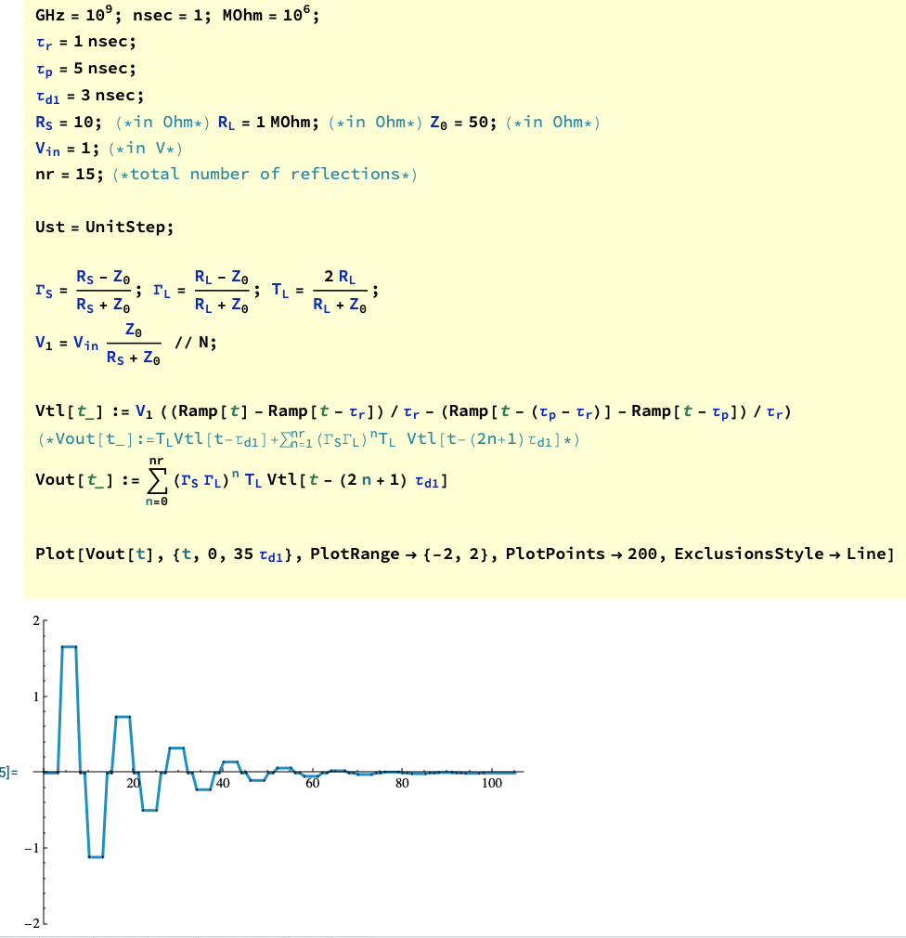
KNU Microwave Convergence Lab.
Practical Teaching Cases
At Kyungpook National University (KNU)
Lecture Note Example 2: Signal Integrity Engineering (Graduate)
15

Slide 16
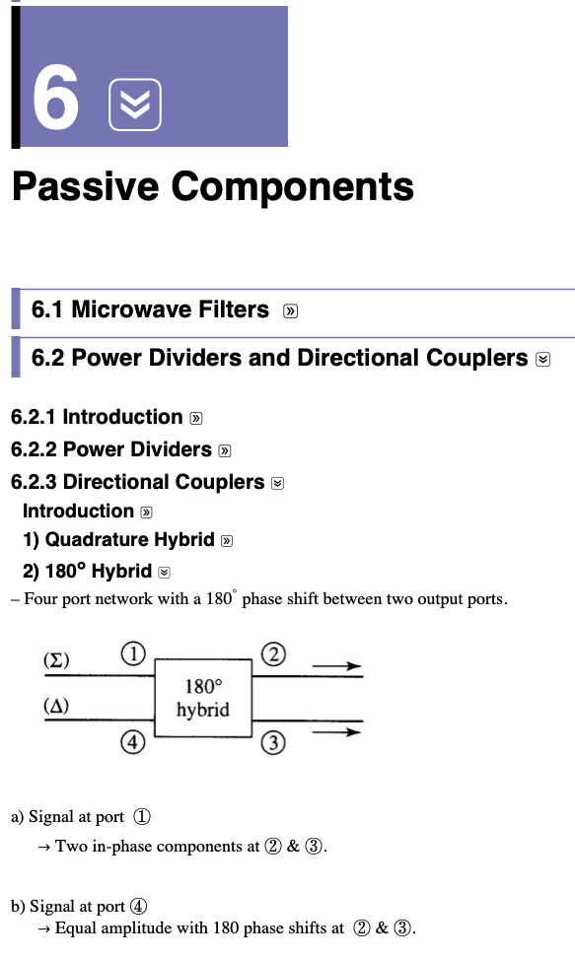
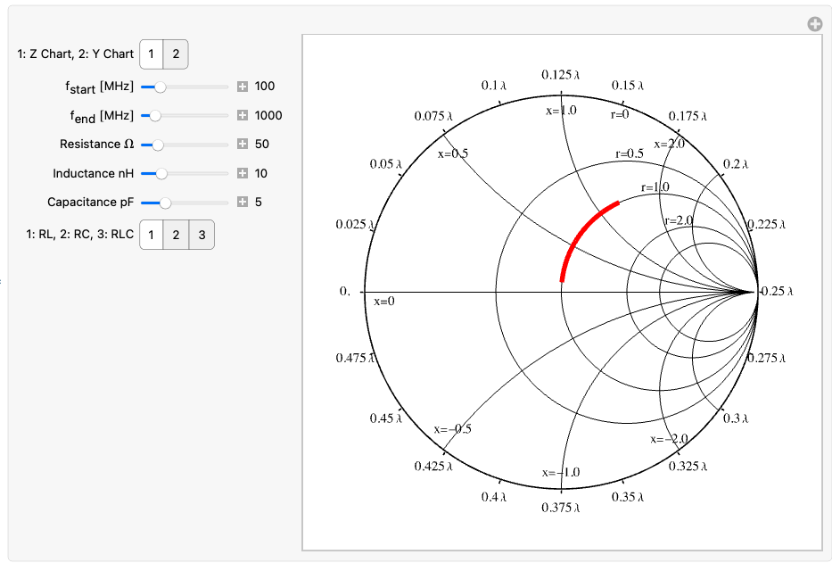
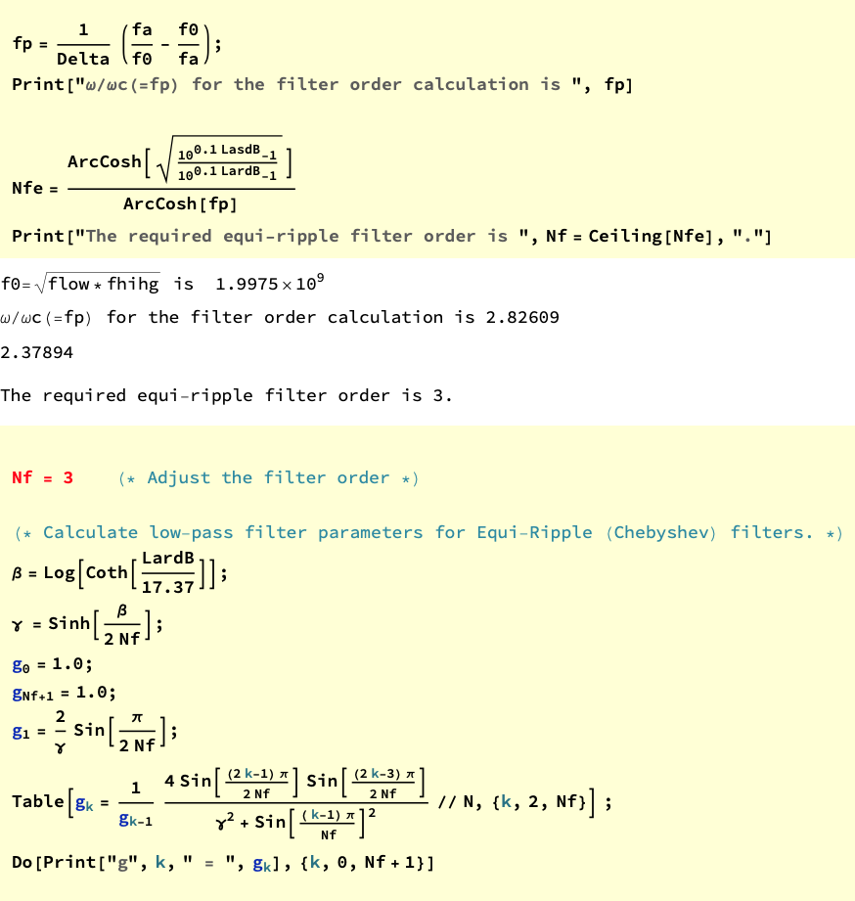
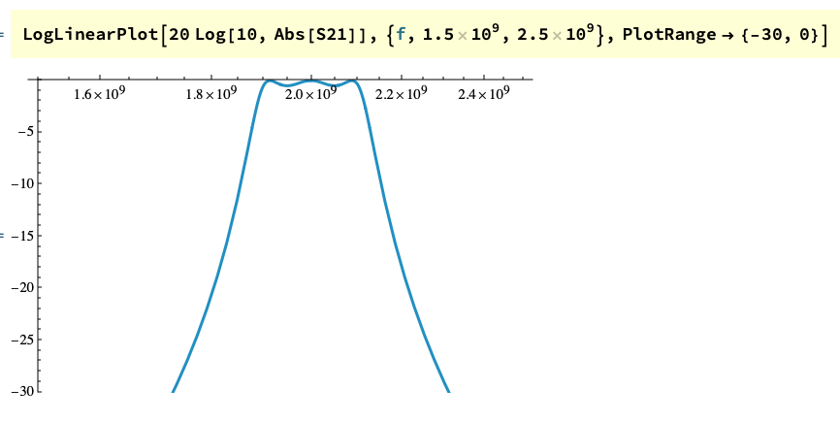
KNU Microwave Convergence Lab.
Practical Teaching Cases
At Kyungpook National University (KNU)
Lecture Note Example 3: Introduction to RF Engin. (Undergraduate)
16

Slide 17
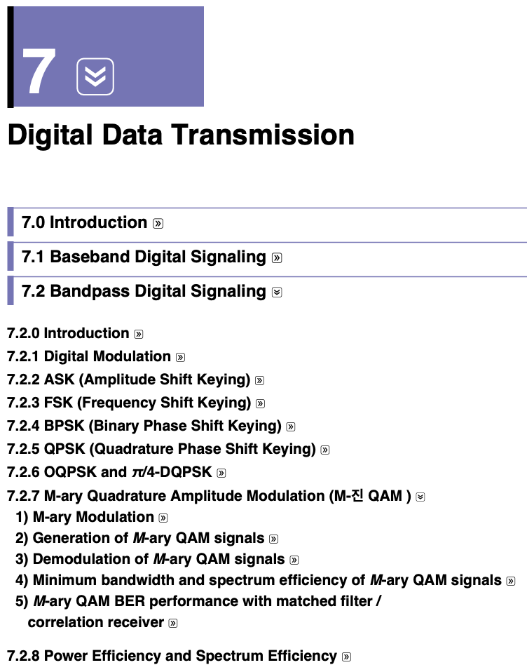
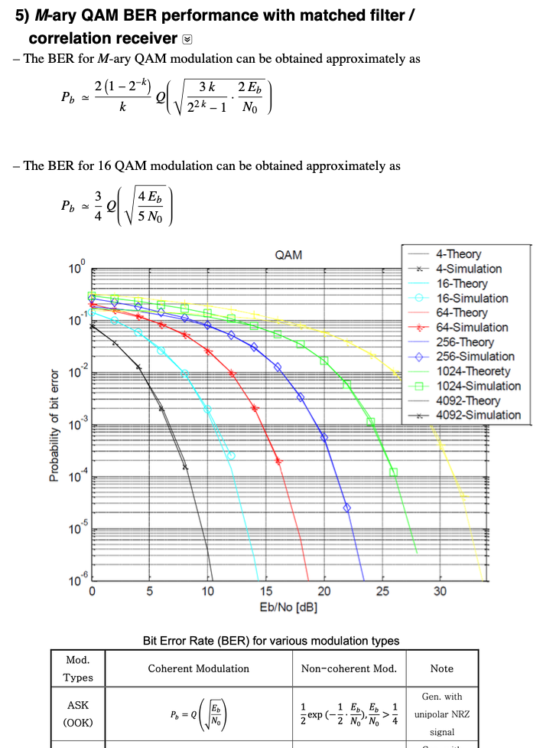
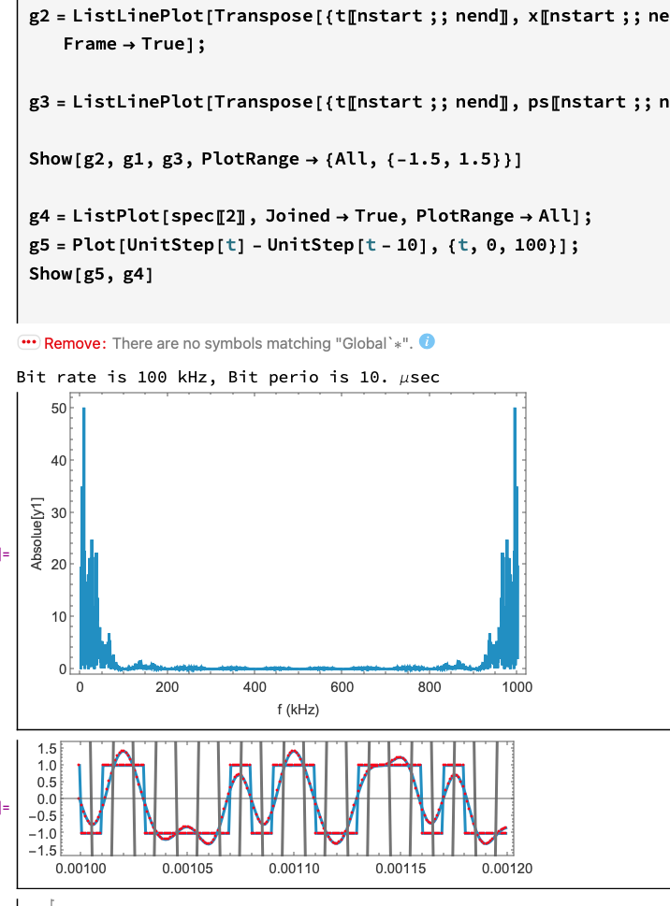
KNU Microwave Convergence Lab.
Practical Teaching Cases
At Kyungpook National University (KNU)
Lecture Note Example 4: Microwave Wireless Comm. (Undergraduate)
17

Slide 18
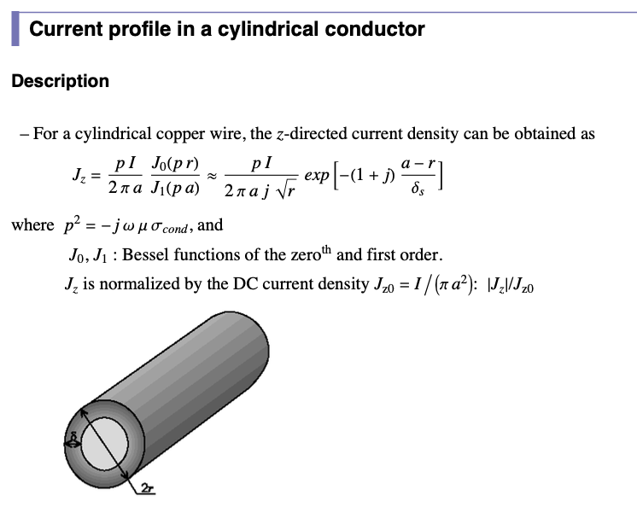
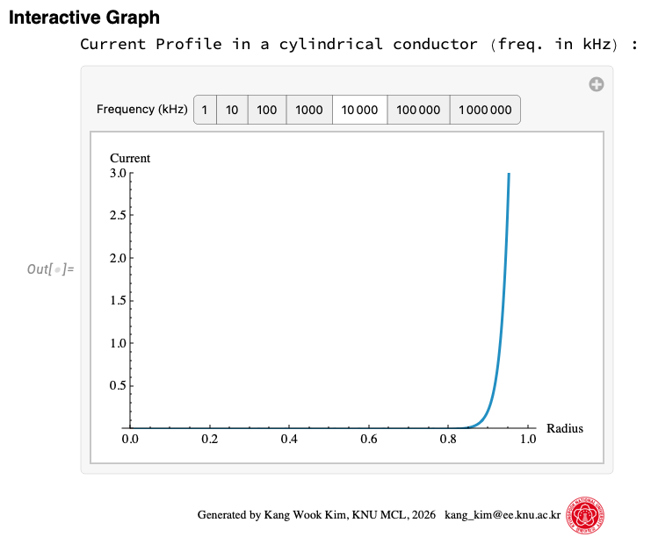
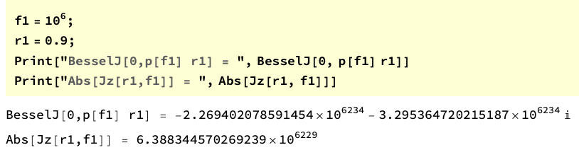
KNU Microwave Convergence Lab.
Practical Teaching Cases
At Kyungpook National University (KNU)
CDF Module Example 1: Current Profile in a Cylindrical Conductor
18

Slide 19
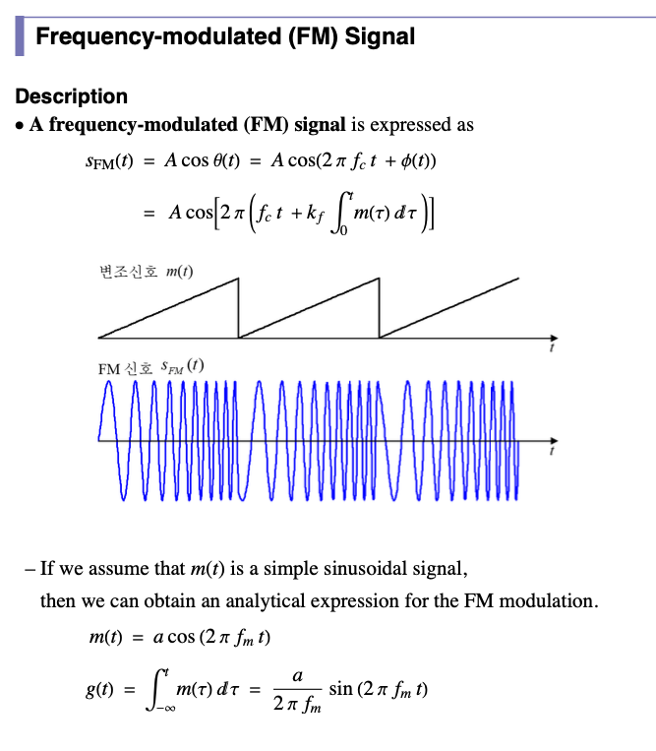
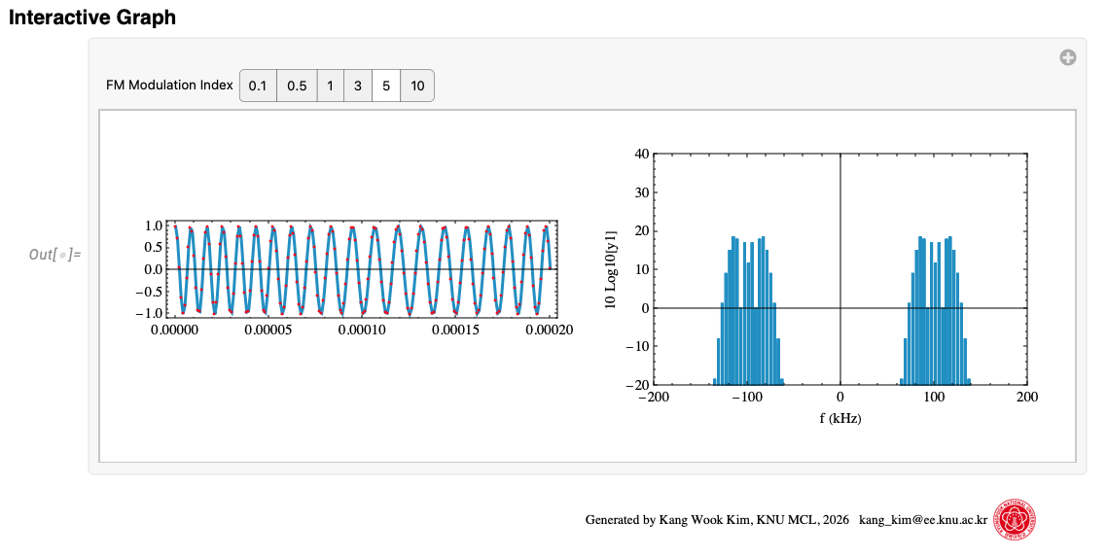
KNU Microwave Convergence Lab.
Practical Teaching Cases
At Kyungpook National University (KNU)
CDF Module Example 2: Frequency-Modulated Signal
19

Slide 20
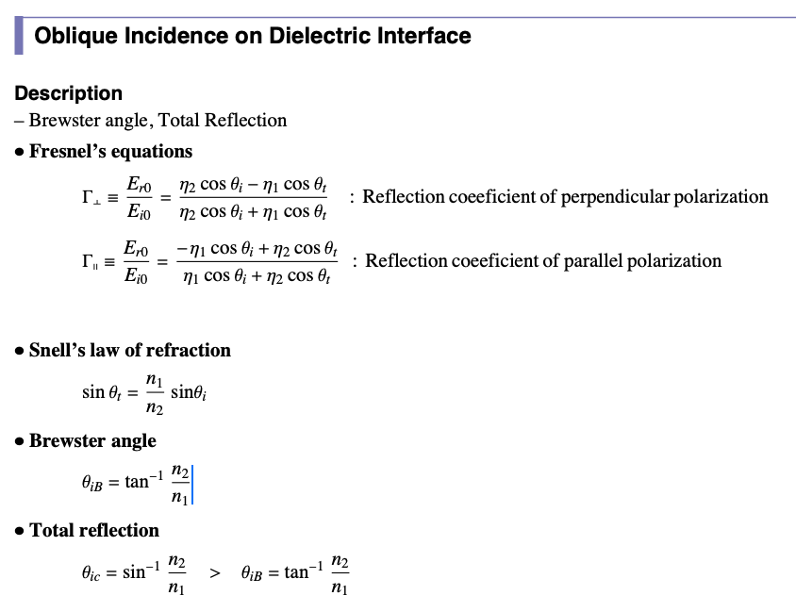
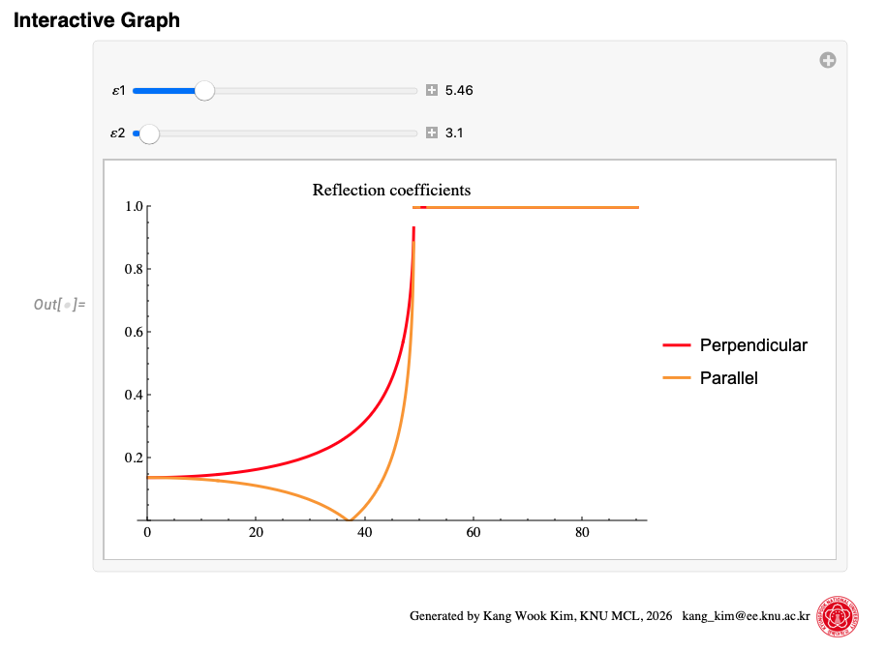
KNU Microwave Convergence Lab.
Practical Teaching Cases
At Kyungpook National University (KNU)
CDF Module Example 3: Oblique Incidence on Dielectric Interface
20

Slide 21
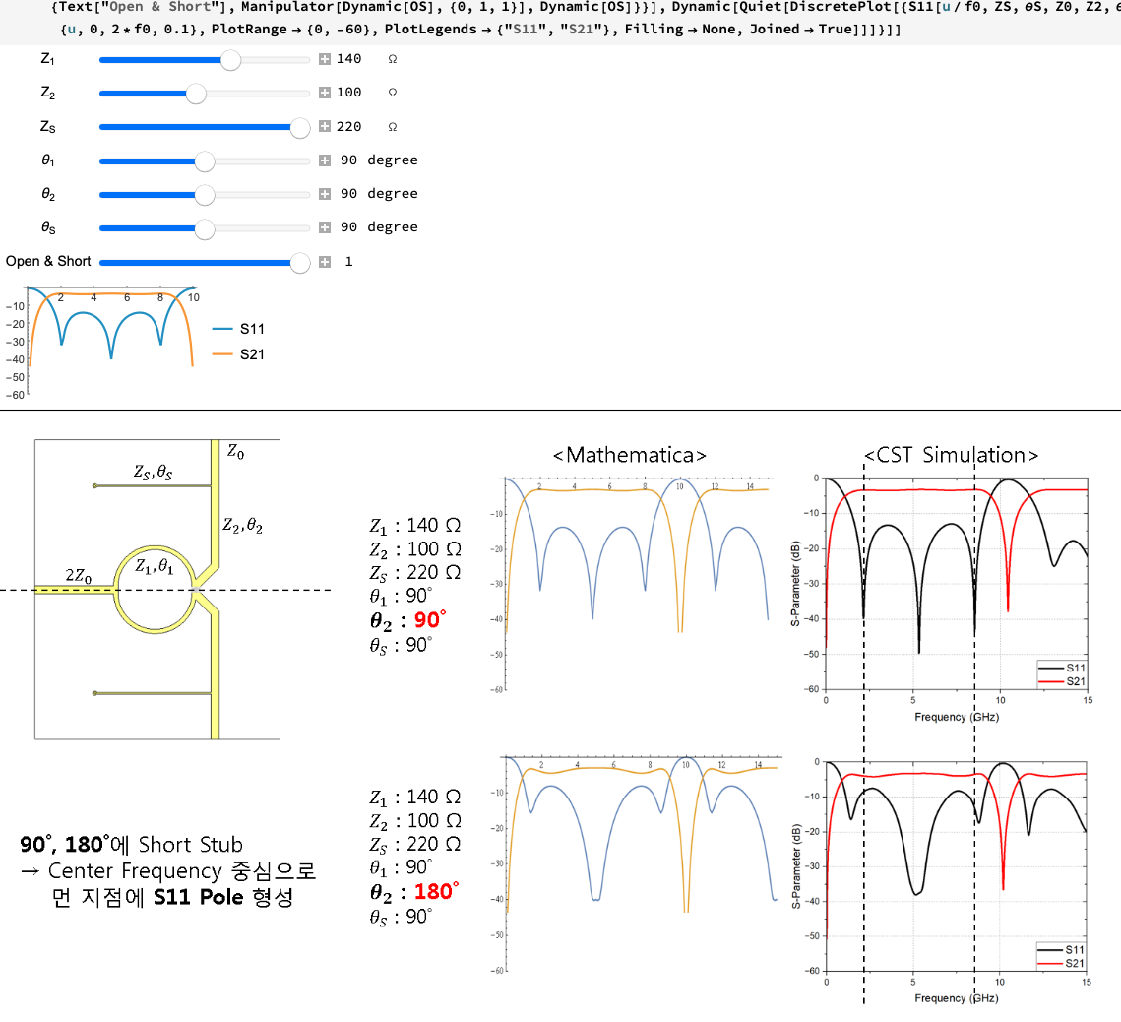
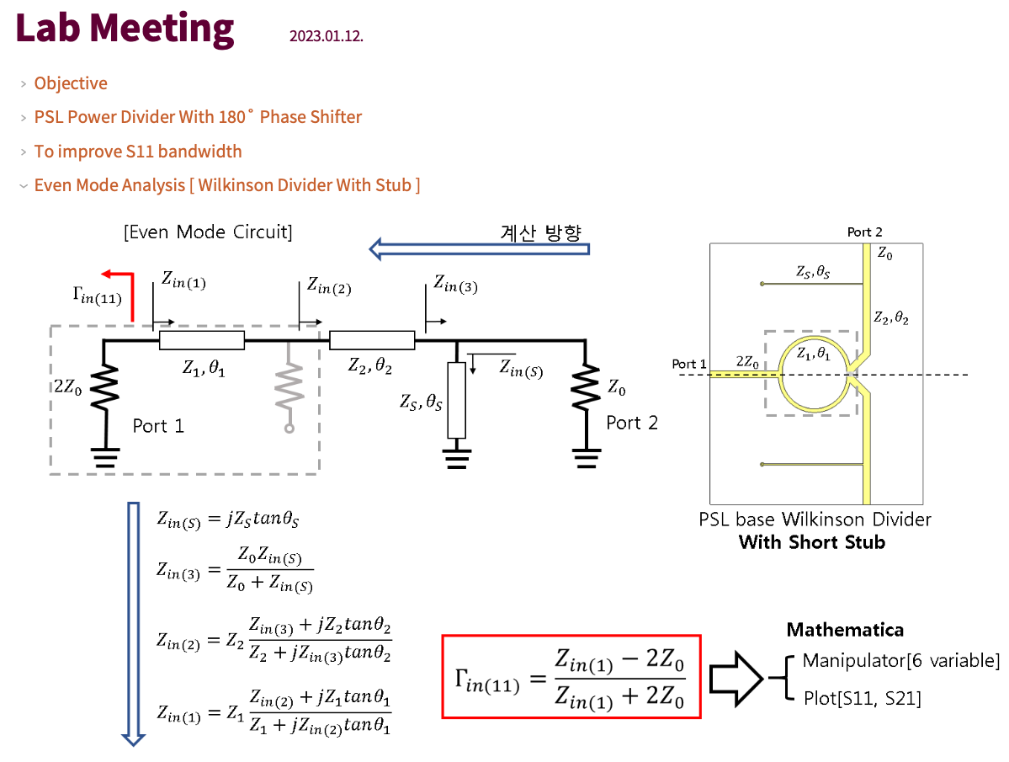
KNU Microwave Convergence Lab.
Practical Teaching Cases
At Kyungpook National University (KNU)
Research Note: Graduate Student
21

Slide 22
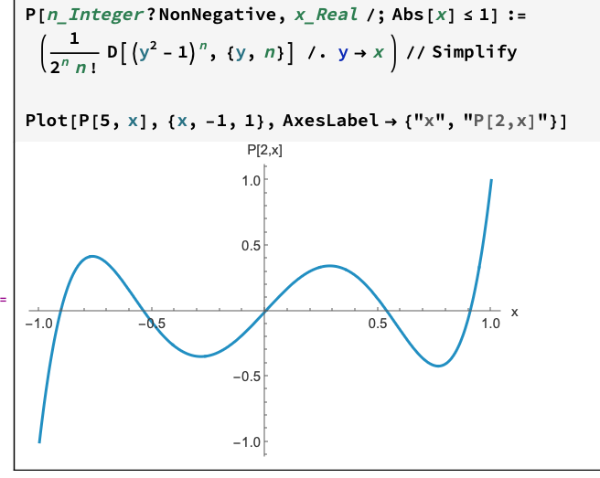
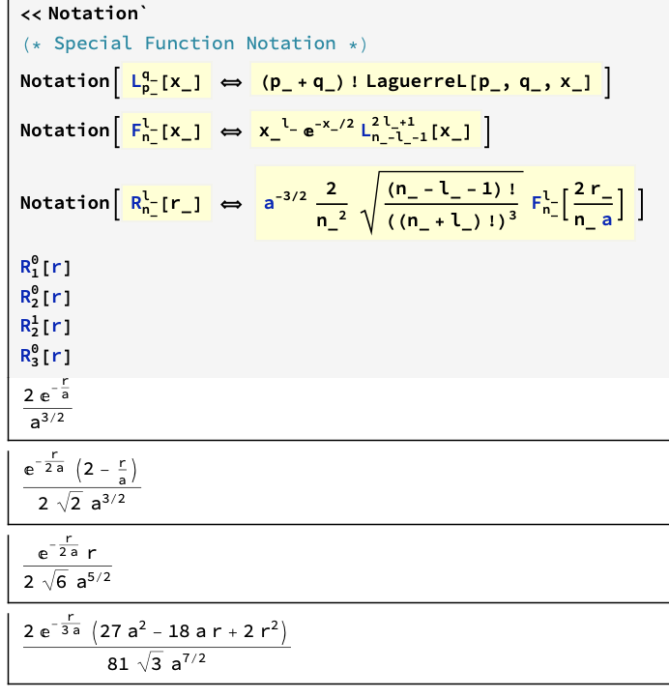
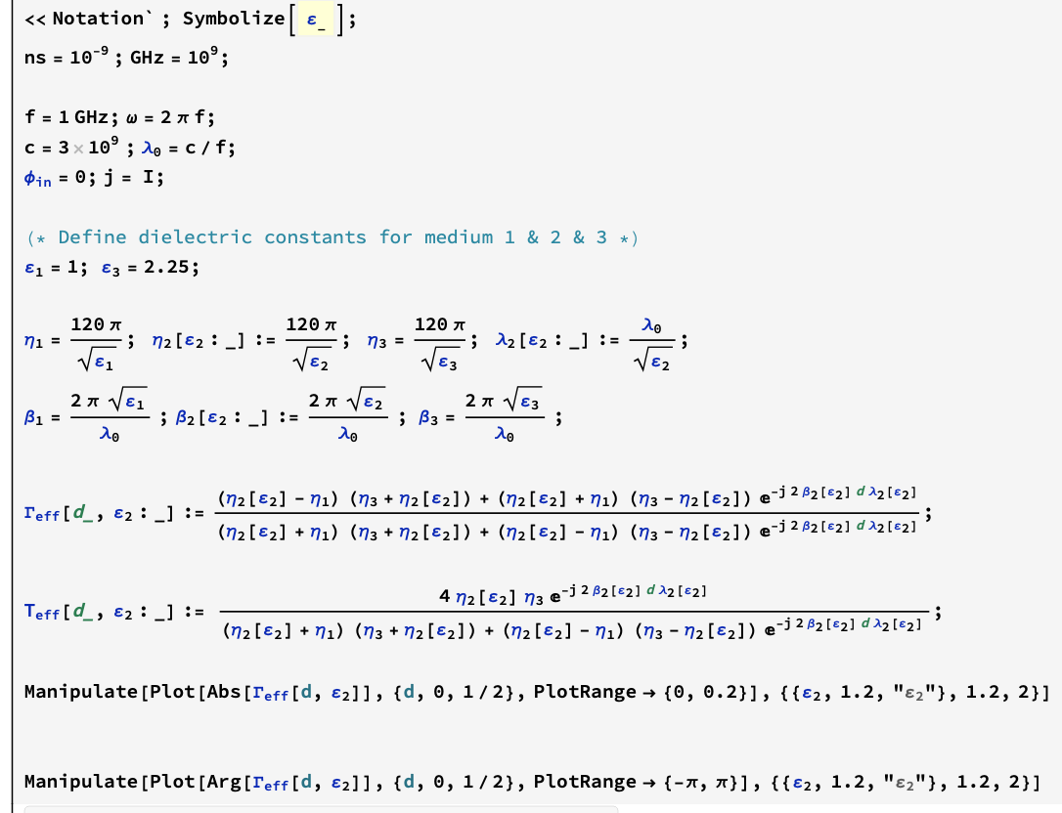
KNU Microwave Convergence Lab.
Practical Teaching Cases
At Kyungpook National University (KNU)
Neat Example: Using Notation
22

Slide 23
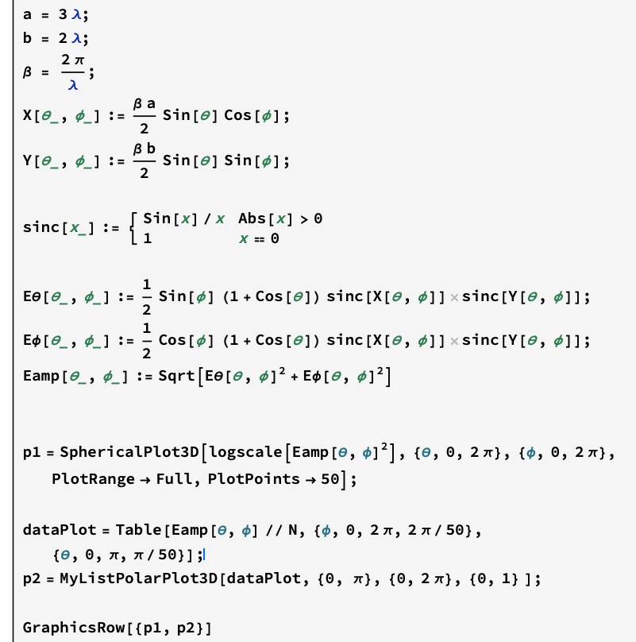
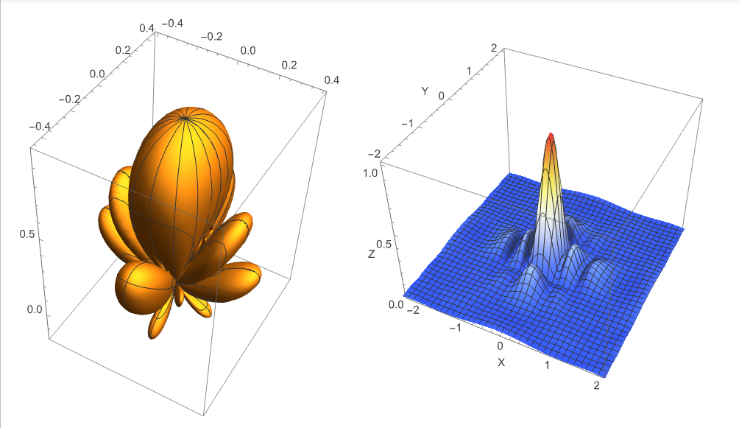
KNU Microwave Convergence Lab.
Practical Teaching Cases
At Kyungpook National University (KNU)
Neat Example: 2D/3D Radiation Patterns
23

Slide 24
KNU Microwave Convergence Lab.
Practical Teaching Cases
At Kyungpook National University (KNU)
Student Use of Wolfram Cloud
Students can use free Wolfram Cloud access to:
Solve and verify homework solutions
Explore extended problems
Develop confidence in their analytical work
24

Slide 25
KNU Microwave Convergence Lab.
Practical Teaching Cases
At Kyungpook National University (KNU)
Mathematica as a Research Notebook for Graduate Students
Graduate students use Mathematica to:
Document derivations, simulations, and experiments
Maintain a clear history of research progress
Experimental data can be:
Directly compared with theoretical predictions
Rapidly updated when models change
Equations, plots, and data are easily exported to:
PowerPoint
Word
Conference and journal papers
25

Slide 26
KNU Microwave Convergence Lab.
Conclusion
Mathematica in Education in the AI Age
Mathematica in Education in the AI Age
In the AI age, understanding becomes more important, not less.
Manual derivation builds foundational thinking, while computational tools enable verification, exploration, and visualization.
Mathematica provides an effective environment that:
Reinforces core principles
Supports deep learning
Complements, rather than replaces, human reasoning and AI tools
EM/RF engineering serves as a concrete example, but the educational methodology is broadly applicable across mathematics, physics, and engineering.
26

Slide 27
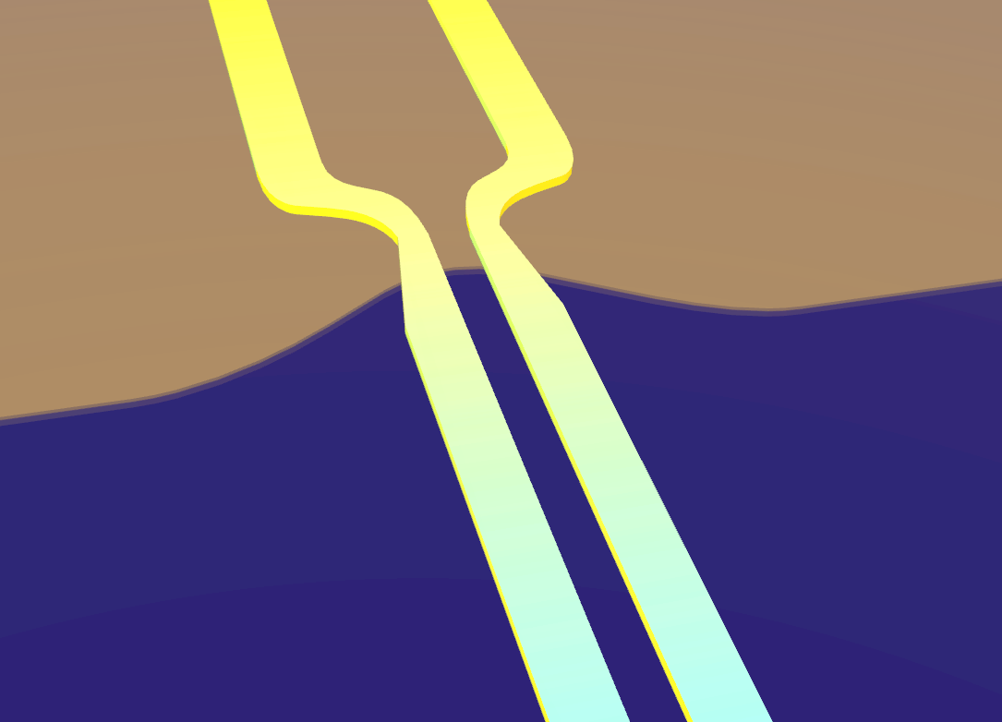
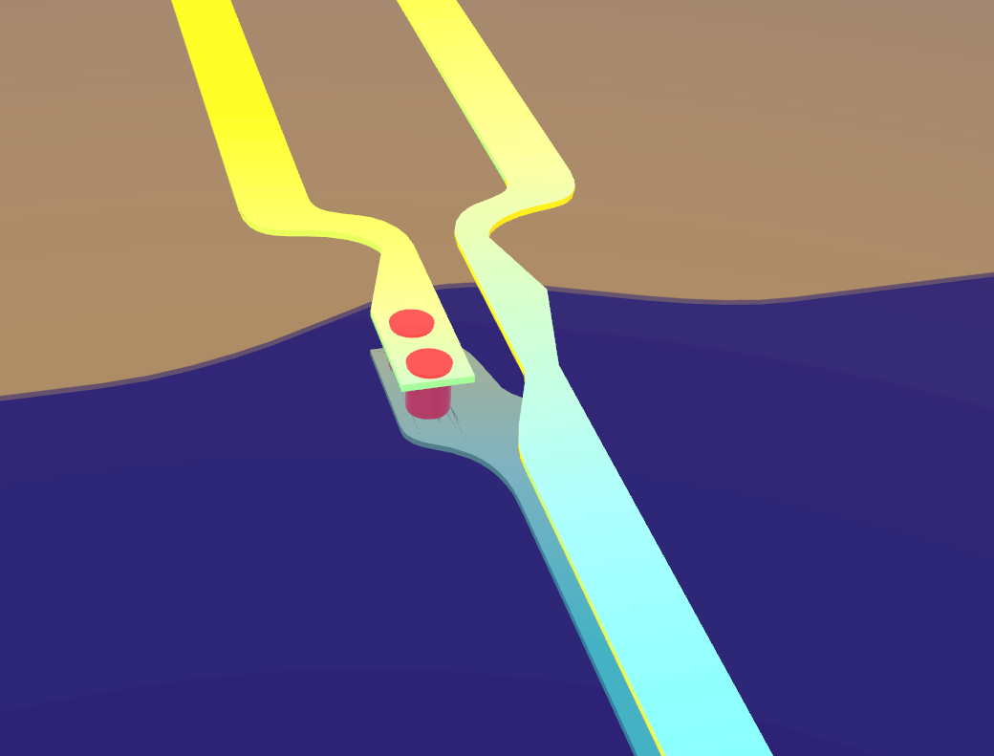

KNU Microwave Convergence Lab.
Thank You
for Listening!

